Slide 1
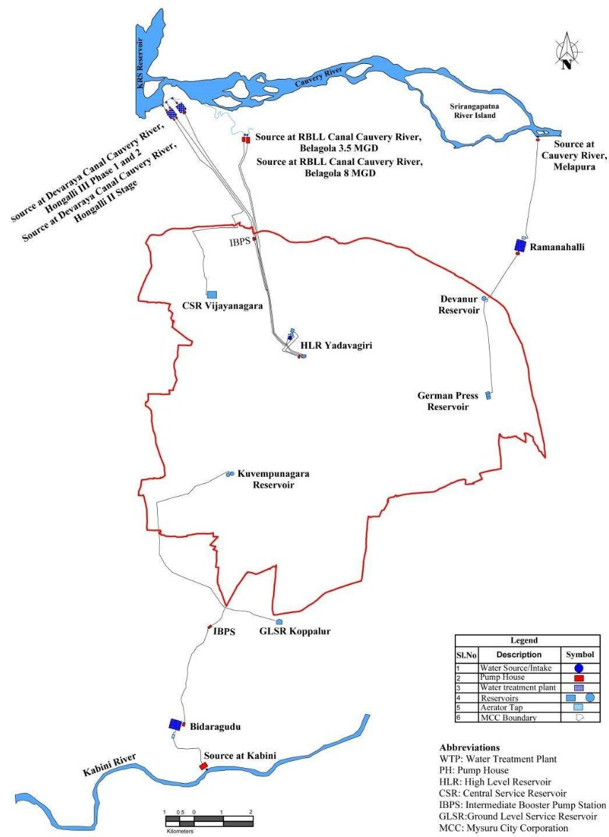
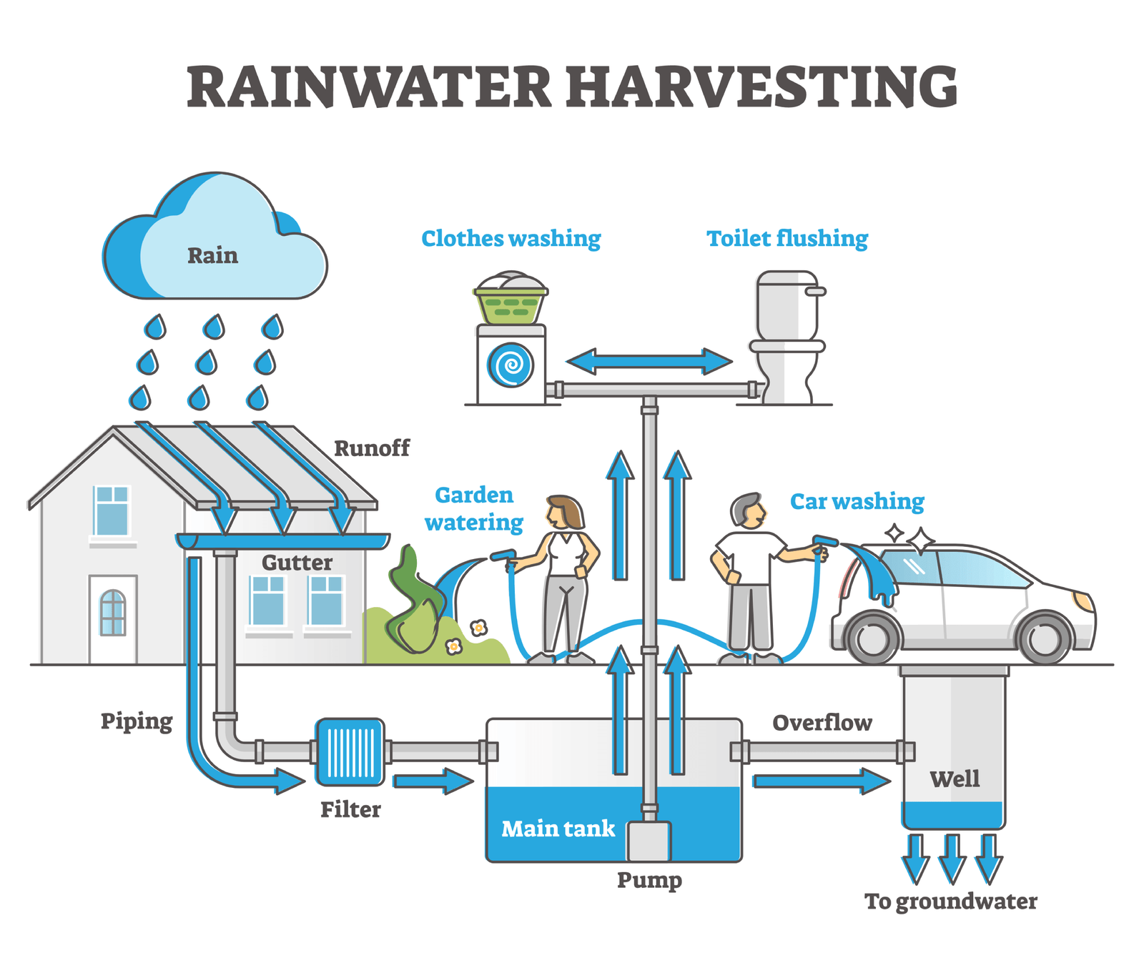
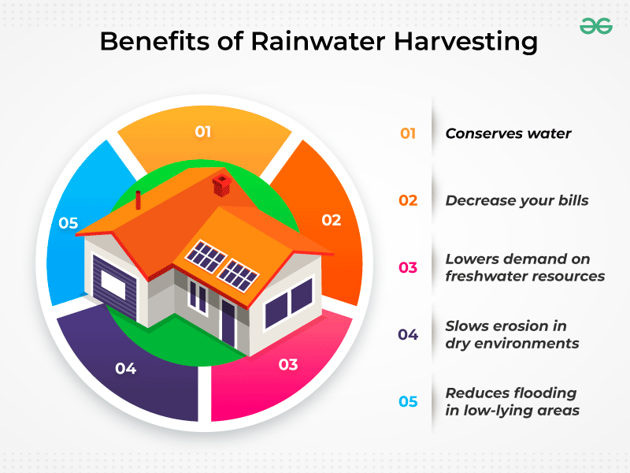
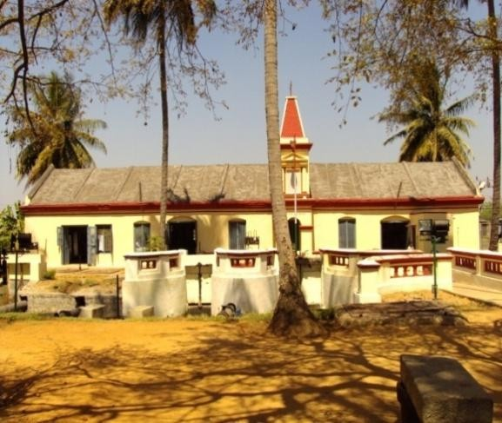
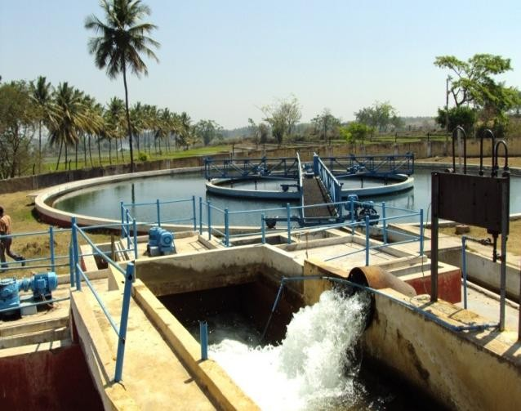
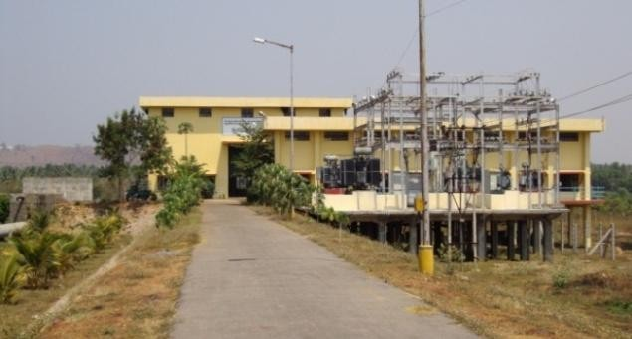
1. WATER SUPPLY
URBAN CORE INFRASTRUCTURE
1.Water Supply:
Due to Climate Change there will be severe impact in the water supply in the future, as it dependent on the Rainfall hence we need to collect the rain water.
The Rainwater Harvesting System should be introduced in addition to the Water Supply Schemes in the ULBs
By implement the Rainwater Harvesting System mandatorily for HHIG, HIG & MIG Houses we can to some extent reduce the reliance on water supply by the Corporation
Balancing reservoirs: The balancing reservoirs to receive the treated water from the various intakes
Distribution System: The distribution system has a total length of 1281 km of pipe line of different diameters laid in a total area of 120 Sqkm in different localities of the city (Inside the ward).
SCHOOL OF PLANNING AND ARCHITECTURE
NAME: MAHAM KAUSAR
REV/EXM:03
Belagola Head works on MC road Hongally Water treatment works Head works at Melapura
DISTRICT DEVELOPMENT PLAN FOR MYSURU DISTRICT
CLASS:3rd Sem, MTech in URP
DRW:02
REG NO:P01ZZ23T107004

